Slide 1
OntoSoar: Using Language to Find Genealogy Facts
Peter Lindes, Deryle Lonsdale, David Embley
Brigham Young University
Family History Technology Workshop, 22 March 2013

Slide 2
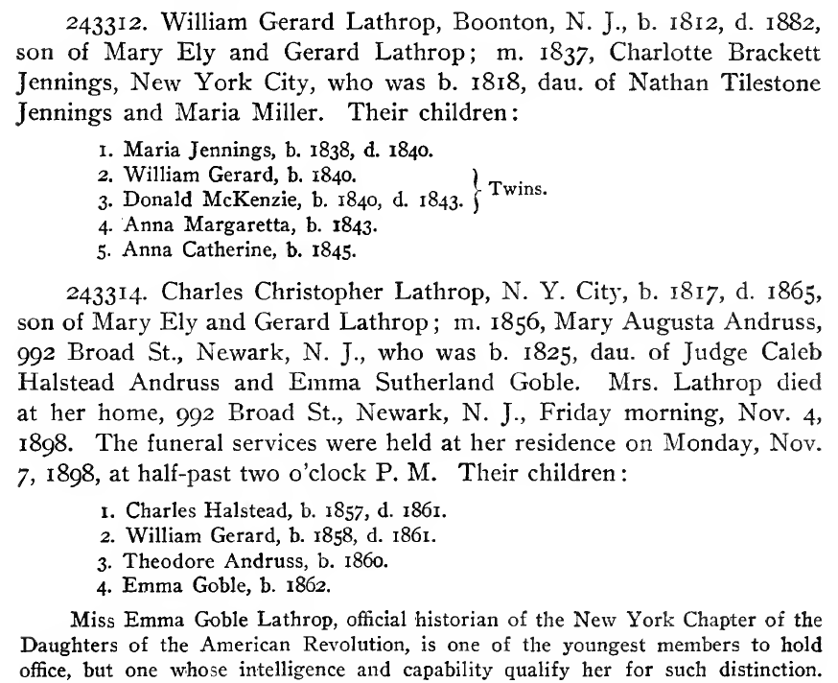
The Challenge

Slide 3
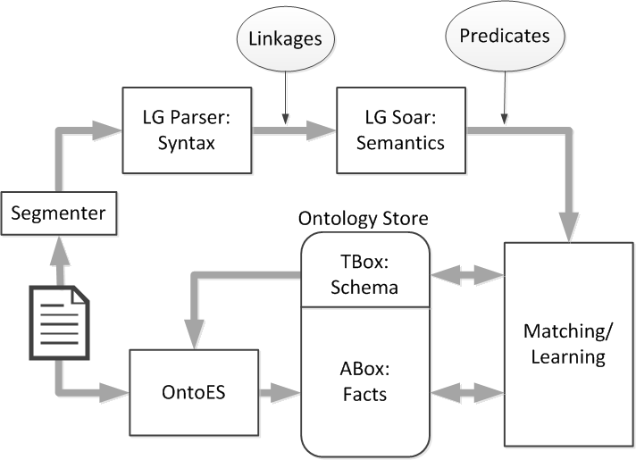
The Solution

Slide 4
Syntax
Charles Christopher Lathrop, b. 1817, d. 1865,
+----------------------------------Xp---------------------------------+
| +------------Ss-----------+ |
+-------------Wd-------------+--MX*p-+------Xc------+ | |
| +----G----+----G----+ +Xd+--MVp--+-IN+ | +--MVp--+-IN+ |
| | | | | | | | | | | | |
LEFT-WALL Charles Christopher Lathrop , b.v [.] in 1817 , d.v [.] in 1865 .
m. 1856, Mary Augusta Andruss,
+---------MX---------+
| +--------Xd-------+
+-Ss+--MVp--+-IN+ | +--G--+---G---+-Xc-+
| | | | | | | | |
*GP* m.v [.] in 1856 , Mary Augusta Andruss ,

Slide 5
Semantics
Charles Christopher Lathrop, b. 1817, d. 1865. in(born,N4) in(died,N6) 1857(N4) Charles(N2) Christopher(N2) Lathrop(N2) born(N2) 1865(N6) died(N2) | NAME(N13,“Charles Christopher Lathrop”) DATE(D43,“1817”) DATE(D44,“1865”) isPerson(P22) hasName(P22,N13) isEvent(E7,“birth”) hasSubject(E7,P22) happenedIn(E7,D43) isEvent(E8,“death”) hasSubject(E8,P22) happenedIn(E8,D44)
m. 1856, Mary Augusta Andruss. in(married,N16) 1856(N16) *GP*(N15) Mary(N18) Augusta(N18) Andruss(N18) married(N15,N18) | NAME(N21,“Mary Augusta Andruss”) DATE(D45,“1856”) isPerson(P23) hasName(P23,N21) isEvent(E9,“marriage”) hasSubject(E9,P22) hasObject(E9,P23) happenedIn(E9,D45) | FAMILY(F27) createdBy(F27,E9) memberOf(P22,F27) memberOf(P23,F27) husbandIn(P22,F27) wifeIn(P23,F27)
Charles Halstead, b. 1857, d. 1861. in(born,N25) in(died,N26) 1857(N25) Charles(N23) Halstead(N23) born(N25) 1861(N26) died(N23) | NAME(N29,“Charles Halstead”) DATE(D46,“1857”) DATE(D47,“1861”) isPerson(P24) hasName(P24,N29) isEvent(E10,“birth”) hasSubject(E10,P24) happenedIn(E10,D46) isEvent(E11,“death”) hasSubject(E11,P24) happenedIn(E11,D47) | memberOf(P24,F27) childIn(P24,F27) NAME(N30,“Charles Halstead Lathrop”) hasName(P24,N30)

Slide 6
Integration
OntoES Facts
PersonName | Person | BirthYear | DeathYear
Charles Christopher Lathrop | osmx411 | 1817 | 1865
Mary Augusta Andruss | osmx415
Charles Halstead | osmx478 | 1857 | 1861
Soar Facts
NAME(N13,“Charles Christopher Lathrop”) DATE(D43,“1817”) DATE(D44,“1865”) isPerson(P22) hasName(P22,N13) isEvent(E7,“birth”) hasSubject(E7,P22) happenedIn(E7,D43) isEvent(E8,“death”) hasSubject(E8,P22) happenedIn(E8,D44) | NAME(N21,“Mary Augusta Andruss”) DATE(D45,“1856”) isPerson(P23) hasName(P23,N21) isEvent(E9,“marriage”) hasSubject(E9,P22) hasObject(E9,P23) happenedIn(E9,D45) | NAME(N29,“Charles Halstead”) DATE(D46,“1857”) DATE(D47,“1861”) isPerson(P24) hasName(P24,N29) isEvent(E10,“birth”) hasSubject(E10,P24) happenedIn(E10,D46) isEvent(E11,“death”) hasSubject(E11,P24) happenedIn(E11,D47) | FAMILY(F27) createdBy(F27,E9) memberOf(P22,F27) memberOf(P23,F27) husbandIn(P22,F27) wifeIn(P23,F27) memberOf(P24,F27) childIn(P24,F27) NAME(N30,“Charles Halstead Lathrop”) hasName(P24,N30)

Slide 7
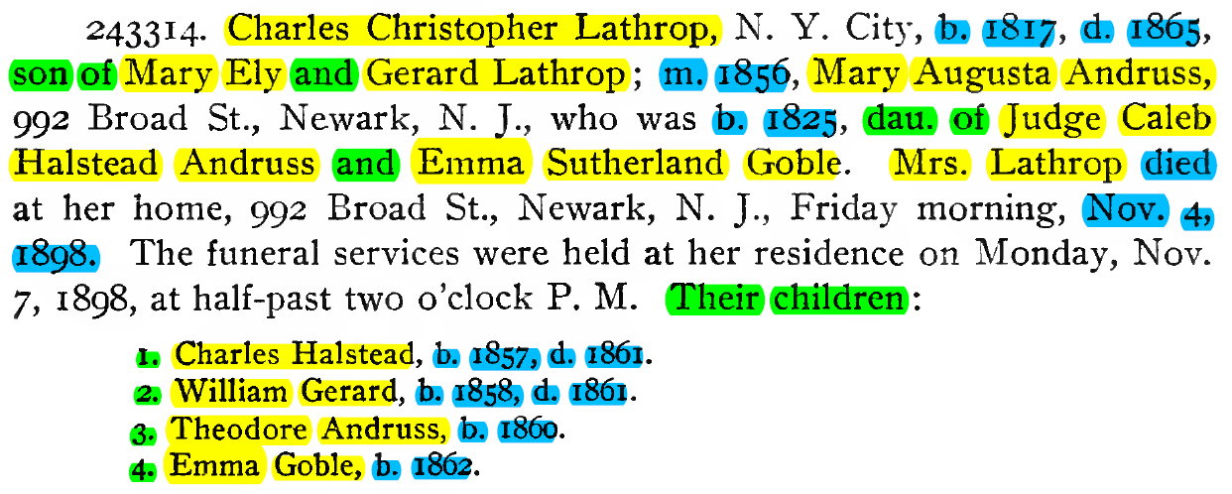
Evaluation

Slide 8
Expected Contributions
Enhance LG Parser robustness for genealogy
Enhance LG-Soar for genealogy
Add inferencing to discover people, events, and family groups
Integrate with other OntoES tools
Find many more facts
Grow the conceptual model with new classes and relations

